Slide 1
Crypto Market Analysis with Unsupervised Learning Methods
All resources in the GitHub repo: https://github.com/MyslfFalcon/Crypto-Market-Analysis

Slide 2
Crypto Market Analysis
Traditional technical analysis (TA) is a method for trading data to identify potential trade opportunity.
Due to the inherent volatility and non-linear relationships within the market, traditional methods often fall short.
This project aims to explore and evaluate Unsupervised Learning methods for cryptocurrency market analysis.

Slide 3
Unsupervised Learning Methods
This project explored the potential of unsupervised learning algorithms, specifically PCA (Principal Component Analysis), t-SNE (t-Distributed Stochastic Neighbor Embedding) and K-means Clustering, for performing cryptocurrency market analysis.

Slide 4
Feature Engineering
Create relevant features from the trading data. This include:
Price changes
Moving averages (e.g., 50-day, 100-day, 200-day)
Volatility indicators (e.g., Bollinger Bands)
Momentum indicators (e.g., RSI, MACD)
Cross signals (e.g., Golden Cross)
etc.

Slide 5
Feature Engineering
Input:
features = df.select_dtypes(include=['number']).columns
print("Extracted Features After Feature Engineering: ")
print(features)
Output:
Extracted Features After Feature Engineering:
Index(['Open', 'High', 'Low', 'Close', 'Volume', 'return', 'close_rsi', 'high_rsi', 'low_rsi', 'sma_50', 'sma_100', 'sma_200', 'std_20', 'bollinger_upper', 'bollinger_lower', 'ema_12', 'ema_26', 'macd', 'signal_line', 'histogram', 'Golden_Cross', 'Death_Cross', 'Overbought', 'Oversold'], dtype='object')

Slide 6
Feature Importance Analysis with PCA
Input:
# Extract features
X = df[features]
# Standardize the features
scaler = StandardScaler()
X_scaled = scaler.fit_transform(X)
# Apply PCA
pca = PCA()
X_pca = pca.fit_transform(X_scaled)
# Print feature importance
feature_importance = pd.DataFrame({'feature': features,'importance': pca.components_[0]})
feature_importance = feature_importance.sort_values('importance', ascending=False)
print("Feature importance for the first principal component:")
print(feature_importance)

Slide 7
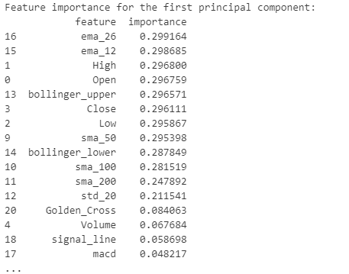
Feature Importance Analysis with PCA
Output:

Slide 8
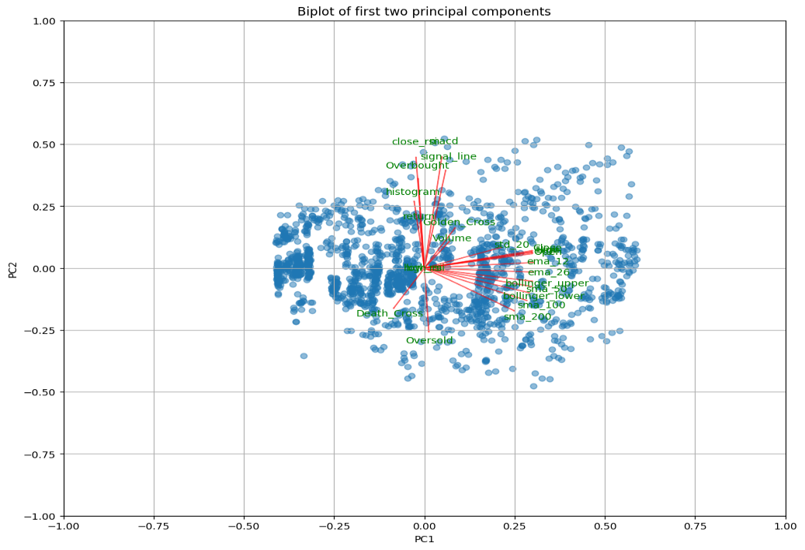

Slide 9
PCA Results Biplot Analysis
Clustering: There are some clusters of observations, suggesting groupings for the given features, we can use k-means clustering to analysis next.
Variable Relationship: Some variables appear to be highly correlated (e.g., "close" and "signal line"), while others seem to have opposing relationships (e.g., "Overbought" and "Oversold").
Variable Importance: Based on arrow length, it appears that "macd" "sinal_line" and "close_rsi" might be relatively important features.

Slide 10
Grouping Cryptos with K-means Clustering
Step by step to group cryptos:
Aggregate data for each cryptocurrency
Prepare data for clustering
Calculate silhouette score to determine n_clusters
Apply K-means clustering
Visualize the clusters
Analyze cluster characteristics

Slide 11
Determine n_clusters by Silhouette Score
# Step3: Calculate silhouette score to determine n_clusters
# Function to calculate average silhouette scores
def calculate_silhouette_scores(data):
silhouette_scores = []
for n in range(2, 9):
kmeans = KMeans(n_clusters=n, init='k-means++', n_init='auto', random_state=42)
cluster_labels = kmeans.fit_predict(data)
silhouette_avg = silhouette_score(data, cluster_labels)
silhouette_scores.append(silhouette_avg)
return silhouette_scores
# Calculate silhouette scores
silhouette_scores = calculate_silhouette_scores(X_scaled)

Slide 12
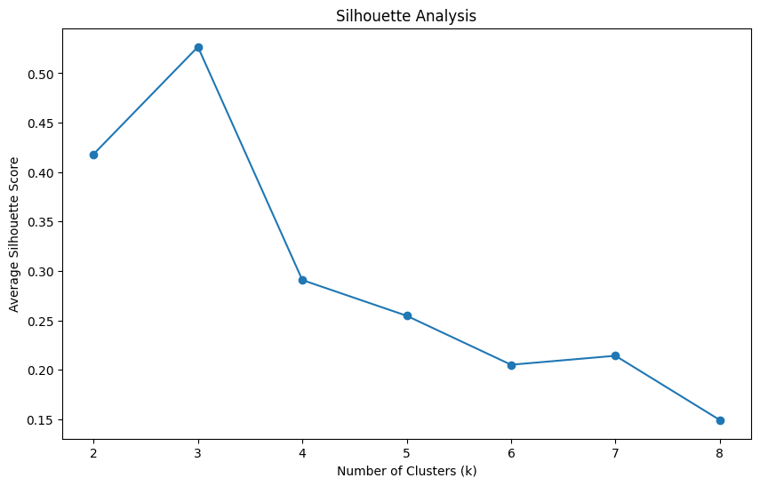

Slide 13
K-means Clustering
n_clusters = 3 # Choose based on the silhouette scores
kmeans = KMeans(n_clusters=n_clusters, init='k-means++', n_init='auto', random_state=42)
cluster_labels = kmeans.fit_predict(X_scaled)
# Add cluster labels to the aggregated data
aggregated_data['Cluster'] = cluster_labels
# Step 5: Visualize the clusters
plt.figure(figsize=(12, 8))
sns.scatterplot(data=aggregated_data, x='volatility', y='volume_intensity', hue='Cluster', palette='viridis')
plt.title('Cryptocurrency Clusters')
plt.xlabel('Volatility')
plt.ylabel('Volume Intensity')
plt.show()

Slide 14
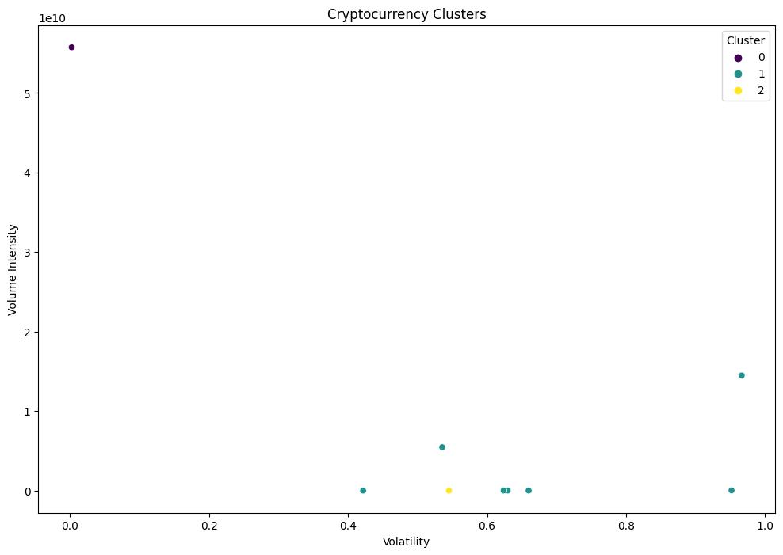

Slide 15
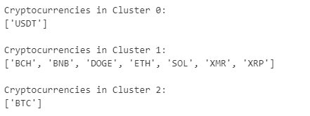
K-means Clustering Result
Input
# Step 6: Analyze cluster characteristics
# Print cryptocurrencies in each cluster
for cluster in range(n_clusters):
print(f"\nCryptocurrencies in Cluster {cluster}:")
print(aggregated_data[aggregated_data['Cluster'] == cluster].index.tolist())
Output

Slide 16
K-means Clustering Result Analysis
Stablecoin: USDT
USDT is a stablecoin pegged to the US dollar. This indicates that its price is relatively stable compared to other cryptocurrencies.
Diverse Group: BCH, BNB, DOGE, ETH, SOL, XMR, XRP
This cluster includes a mix of large-cap and mid-cap cryptocurrencies with varying degrees of volatility.
Dominance: BTC
BTC is the largest cryptocurrency by market capitalization.

Slide 17
Evaluate Clustering Result with t-SNE
# Apply t-SNE
tsne = TSNE(n_components=2, random_state=42, perplexity=8, n_iter=1000)
tsne_results = tsne.fit_transform(X_scaled)
# Create a DataFrame with t-SNE results
tsne_df = pd.DataFrame(data=tsne_results, columns=['t-SNE1', 't-SNE2'])
tsne_df['Cluster'] = cluster_labels
tsne_df['Cryptocurrency'] = aggregated_data.index
# Visualize t-SNE results with cryptocurrency names
plt.figure(figsize=(12, 8))
sns.scatterplot(data=tsne_df, x='t-SNE1', y='t-SNE2', hue='Cluster', palette='viridis', legend='full')
for i, txt in enumerate(tsne_df['Cryptocurrency']):
plt.annotate(txt, (tsne_df['t-SNE1'].iloc[i], tsne_df['t-SNE2'].iloc[i]), fontsize=8)
plt.title('t-SNE visualization of cryptocurrency clusters')

Slide 18
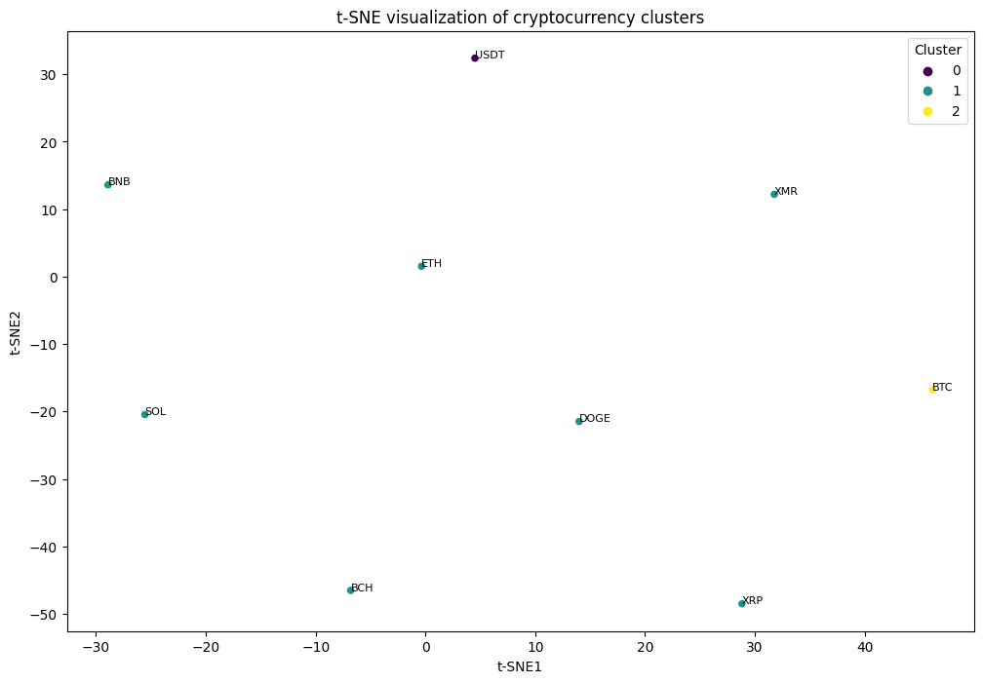

Slide 19
t-SNE Result Analysis
In the t-SNE plot, we can see the clusters are clearly separated, this suggest the K-means clustering has found meaningful structure in the data.

Slide 20
Conclusion
The This project explored the potential of unsupervised learning algorithms, specifically PCA (Principal Component Analysis), t-SNE (t-Distributed Stochastic Neighbor Embedding) and K-means Clustering, for performing cryptocurrency market analysis.
While the project contributes to the ongoing investigation of machine learning in financial analysis, the results highlight the challenges associated with this task, we will continue to explore advanced methods to analyze the market in the future.

Slide 21
Thank you & Best Regards

